Slide 1
Crypto
Nik and Christine

Slide 2
Intro to Crypto
NIk
Bitcoin: Decentralized Currency/Store of Value
Ethereum: programmable platform
Stablecoin/Altcoins/
Memecoins
Notes:
Bitcoin is the original and largest by market cap, designed purely as a decentralized currency and store of value. Ethereum is the second largest and functions more like a programmable platform, allowing developers to build applications and smart contracts on top of it. Stablecoins like USDT (Tether) and USDC are pegged to the US dollar and designed to eliminate volatility. Altcoins is the broad term for every other cryptocurrency, including Solana, Cardano, and Ripple. Memecoins like Dogecoin and Shiba Inu started as jokes but attracted massive speculative investment.

Slide 3
THe 2008 Global Financial Crisis
NIk
Lehman Brothers collapsed September 15, 2008 — $613 billion in debt,
Over 500 U.S. banks failed in the months that followed
The largest Bankruptcy filing in US history
Notes:
To understand why cryptocurrencies exist, you have to understand the world that created them — a world defined by one of the most catastrophic financial collapses in modern history. On September 15th, 2008, Lehman Brothers filed for bankruptcy with over $613 billion in debt, making it the largest bankruptcy filing in U.S. history. But Lehman was just the most visible domino. In the weeks and months that followed, over 500 banks failed in the United States alone.

Slide 4
THe 2008 Global Financial Crisis
NIk
S&P 500 lost 57% of its value, wiping out $11 trillion in U.S. household wealth
Global stock markets lost an estimated $25 trillion in 2008
U.S. unemployment doubled (5%->10%)
Notes:
The S&P 500 lost approximately 57% of its value between October 2007 and March 2009, wiping out roughly $11 trillion in household wealth in the U.S. alone. Global stock markets lost an estimated $25 trillion in value in 2008. Unemployment in the U.S. climbed from 5% in 2007 to 10% by October 2009 — the highest rate since 1983 — leaving 15 million Americans out of work. In the Eurozone, unemployment hit 12.1% by 2013 as the crisis rippled into a sovereign debt crisis across Greece, Spain, Portugal, and Ireland.

Slide 5
THe 2008 Global Financial Crisis
NIk
U.S. banks issued $1.3 trillion in subprime mortgages
Bad mortgages were bundled into mortgage-backed securities, falsely rated AAA by Moody's and Standard & Poor's
Notes:
The root cause was systematic, institutionalized recklessness. U.S. banks had issued roughly $1.3 trillion in subprime mortgages by 2007 — loans given to borrowers with poor credit histories and little ability to repay. These mortgages were then bundled into complex financial instruments called mortgage-backed securities and collateralized debt obligations, stamped with AAA credit ratings by agencies like Moody's and Standard & Poor's despite being built on fundamentally unstable debt.

Slide 6
THe 2008 Global Financial Crisis
NIk
U.S. house prices fell 30% on average (2006–2009),
Government deployed $700 billion via TARP to bail out the banks that caused the crisis
Notes:
When U.S. house prices fell by an average of 30% between 2006 and 2009 — with some markets like Las Vegas and Phoenix falling over 50% — those securities collapsed in value. The government's response was to deploy $700 billion through the Troubled Asset Relief Program to bail out the banks responsible. The Federal Reserve slashed interest rates to near zero and launched quantitative easing programs that would eventually expand its balance sheet from $900 billion in 2008 to over $4.5 trillion by 2015 — essentially creating trillions of new dollars to stabilize a system that had failed through its own greed. For ordinary people who had lost jobs, homes, and retirement savings, this was the moment trust in the financial system broke entirely.

Slide 7

THe Trust in Banks and Financial Intermediaries
NIk
Banks are intermediaries - Trust is the foundation:
2008 revealed banks were overleveraged, opaque, and poorly regulated
Notes:
"The 2008 crisis didn't just cause economic damage — it exposed a fundamental fragility at the core of how modern banking works. Banks are financial intermediaries, meaning they sit between savers and borrowers, holding deposits and lending them out at a profit. The entire system operates on trust — the assumption that your money is safe, that the bank is solvent, and that when you want your money back, it will be there. But under fractional reserve banking — the system used by virtually every bank in the world — banks are only required to hold a fraction of their deposits as actual cash reserves.

Slide 8
THe Trust in Banks and Financial Intermediaries
NIk
Fractional reserve banking: banks only hold a fraction of deposits
Central banks can inflate the money supply, eroding the value of savings
Notes:
In the U.S., reserve requirements before 2020 were as low as 10%, meaning a bank could hold $1 billion in deposits while keeping only $100 million in actual reserves and lending out the rest. In March 2020, the Federal Reserve actually reduced reserve requirements to zero percent. This means the entire system is structurally dependent on the assumption that not everyone will try to withdraw their money at once — and when that assumption breaks, as it did in 2008, the system collapses.The numbers illustrate just how exposed banks were. By 2008, major investment banks like Lehman Brothers and Bear Stearns had leverage ratios of approximately 30 to 1 — meaning for every $1 of their own capital, they had borrowed and invested $30.

Slide 9
Start of something new
NIk
Satoshi Nakamoto published the Bitcoin whitepaper in 2008
Core idea: remove the need for a trusted third party
Notes:
"On October 31st, 2008 — just 46 days after Lehman Brothers collapsed — an anonymous individual or group using the pseudonym Satoshi Nakamoto published a nine-page document titled 'Bitcoin: A Peer-to-Peer Electronic Cash System.' The timing was deliberate. Embedded in the very first Bitcoin block ever mined, on January 3rd, 2009, was a headline from The Times newspaper: 'Chancellor on Brink of Second Bailout for Banks.' It was a timestamp, yes — but it was also a political statement. Bitcoin was explicitly designed as a response to institutional failure. The core proposition was simple but revolutionary: what if you could transfer value directly from one person to another, anywhere in the world, at any time, without needing a bank, a government, a payment processor, or any trusted third party to authorize or record the transaction? Every dollar transferred through a bank requires that bank to maintain records, approve the transaction, potentially freeze or reverse it, and charge fees for the privilege. Bitcoin proposed to eliminate all of that.

Slide 10
Vision of Decentralized Money
NIk
Peer-to-peer transactions
No single authority controls the supply Decentralized
Notes:
The economic philosophy behind Bitcoin drew heavily from a tradition called the Austrian School of Economics, which emphasizes sound money, limited government intervention, and skepticism of central banking. Nakamoto designed Bitcoin with a mathematically fixed maximum supply of exactly 21 million coins — a deliberate contrast to fiat currencies, whose supply governments can expand at will. To put that in perspective, the U.S. M2 money supply — a broad measure of money in circulation — grew from approximately $7.4 trillion in 2008 to over $21 trillion by 2022, nearly tripling in 14 years. Bitcoin's supply, by contrast, is pre-programmed and cannot be altered by any individual, government, or institution. New Bitcoin is released on a predictable schedule through a process called halving, where the reward for mining is cut in half approximately every four years — meaning Bitcoin's inflation rate is known years in advance and is programmed to approach zero. By January 2009, when Bitcoin's network launched, its total market value was essentially zero. By November 2021, it had reached a peak market capitalization of approximately $1.27 trillion. The idea of sovereign, censorship-resistant, mathematically scarce money had captured the imagination of millions — and the economic case for why it was needed had been written by the financial crisis itself."

Slide 11
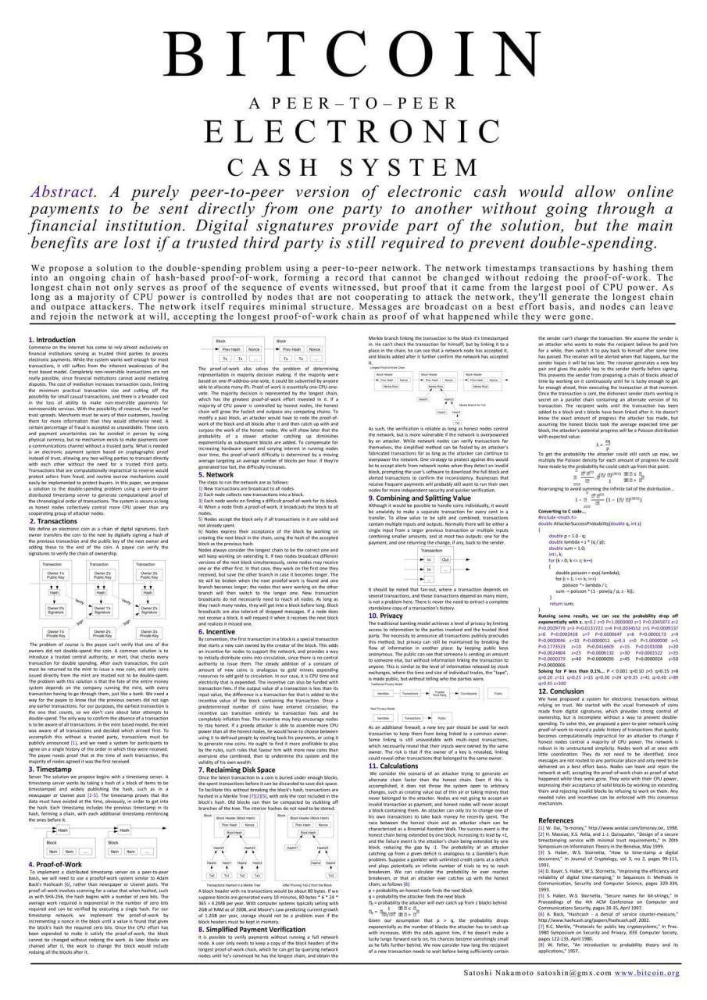
NIk

Slide 12
The Basic Design Logic of Bitcoin
NIk
Blockchain: a distributed public ledger of all transactions, verified by a network of computers
Mining & Proof of Work: computers compete to validate transactions, earning Bitcoin as a reward
Notes:
Bitcoin's technical design is built to solve a problem that had stumped computer scientists for decades: how do you create digital money that can't be copied or spent twice, without relying on a central authority to keep track of who owns what? This is called the double-spend problem. With physical cash, you hand over a bill and it's gone — you can't spend it again. But with a digital file, copying is trivial. The solution Nakamoto devised was the blockchain — a public, distributed ledger of every single Bitcoin transaction ever made, simultaneously stored on thousands of computers around the world. Every ten minutes, a new 'block' of recent transactions is added to the chain, verified by the network through a process called Proof of Work. To add a fraudulent transaction, an attacker would need to redo the computational work for that block and every block after it, faster than the entire honest network combined — a task that would currently require more computing power than all of the world's top 500 supercomputers combined, making successful attacks essentially economically irrational.

Slide 13
The Basic Design Logic of Bitcoin
NIk
Only 21 million Bitcoin will ever exist, built-in scarcity
Cryptographic security: transactions are secured through advanced mathematical encryption
Notes:
The mining process that secures this network is enormous in scale. As of 2024, the Bitcoin network's total computing power — measured in hash rate — exceeded 600 exahashes per second, meaning it performs 600 quintillion calculations every second. The energy consumption of Bitcoin mining is estimated at approximately 120–150 terawatt-hours per year, comparable to the annual electricity consumption of a country like Argentina or Poland. Critics cite this as a major environmental flaw; supporters argue it is the price of security and sovereignty. Each miner who successfully validates a block receives newly created Bitcoin as a reward — currently 3.125 Bitcoin per block following the April 2024 halving, down from 50 Bitcoin at launch in 2009. This reward, combined with transaction fees, incentivizes miners to keep securing the network honestly. The fixed supply of 21 million Bitcoin — of which approximately 19.7 million had been mined by early 2025 — creates scarcity by design. Roughly 3 to 4 million Bitcoin are estimated to be permanently lost, locked in wallets whose owners have died or lost their private keys, making the effective circulating supply even smaller. This combination of provable scarcity, decentralized security, and transparent issuance was designed to create a form of money that is more auditable, more predictable, and more resistant to political manipulation than any government currency in history."

Slide 14

Medium of Exchange
NIk
Used to buy and sell goods and services
Bitcoin processes ~7 transactions per second vs. Visa's ~24,000
High and unpredictable transaction fees during peak network congestion

Slide 15
Medium of Exchange
NIk
Merchants rarely accept crypto
El Salvador adopted Bitcoin as legal tender
Solutions exist (Lightning Network) but adoption is slow and technically complex
Notes:
The mining process that secures this network is enormous in scale. As of 2024, the Bitcoin network's total computing power — measured in hash rate — exceeded 600 exahashes per second, meaning it performs 600 quintillion calculations every second. The energy consumption of Bitcoin mining is estimated at approximately 120–150 terawatt-hours per year, comparable to the annual electricity consumption of a country like Argentina or Poland. Critics cite this as a major environmental flaw; supporters argue it is the price of security and sovereignty. Each miner who successfully validates a block receives newly created Bitcoin as a reward — currently 3.125 Bitcoin per block following the April 2024 halving, down from 50 Bitcoin at launch in 2009. This reward, combined with transaction fees, incentivizes miners to keep securing the network honestly. The fixed supply of 21 million Bitcoin — of which approximately 19.7 million had been mined by early 2025 — creates scarcity by design. Roughly 3 to 4 million Bitcoin are estimated to be permanently lost, locked in wallets whose owners have died or lost their private keys, making the effective circulating supply even smaller. This combination of provable scarcity, decentralized security, and transparent issuance was designed to create a form of money that is more auditable, more predictable, and more resistant to political manipulation than any government currency in history."

Slide 16
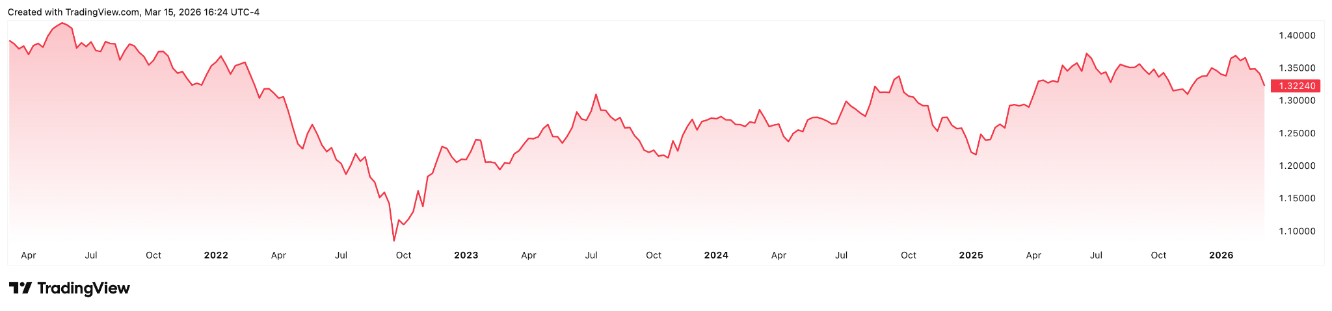
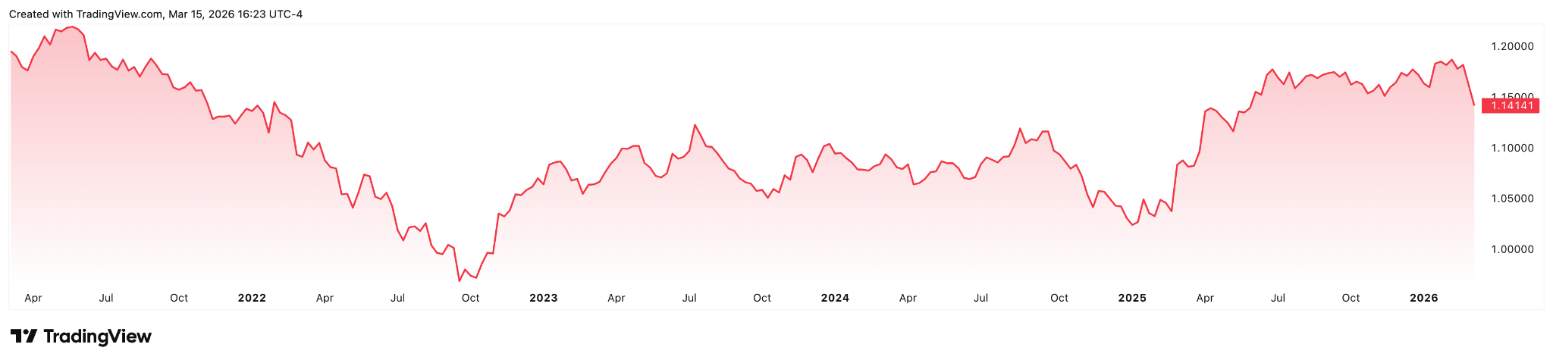
NIk
Dollar to pound
Dollar to Euro
Notes:
Top is dollar to pound
Bottom is dollar to euro

Slide 17
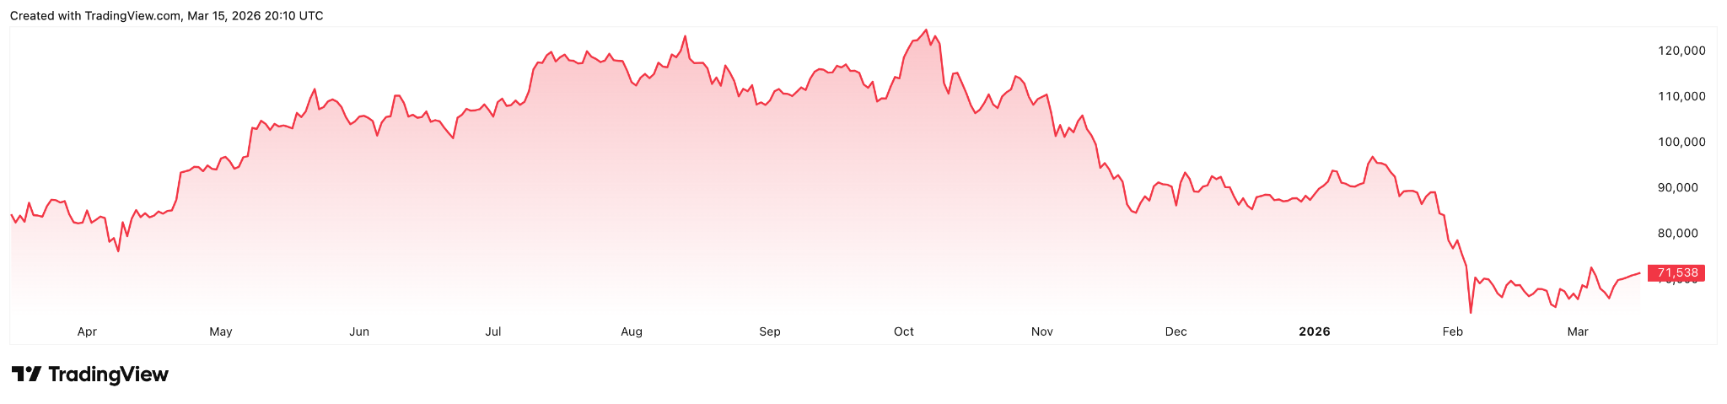
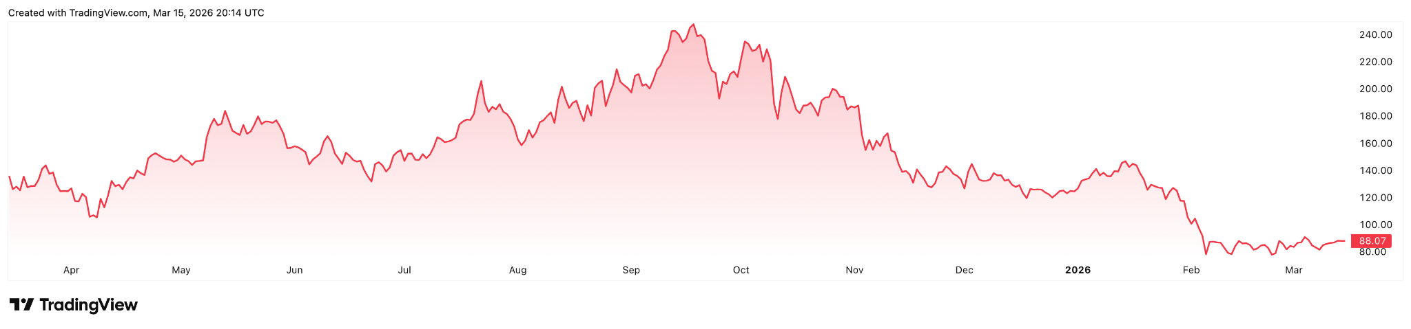
NIk
Notes:
Top is the value of bitcoin
Bottom is the value of soloana

Slide 18
Store of Value & Unit of Account
NIk
Gold annualized volatility: ~15–20%
Bitcoin's: regularly 80–100%
2018 crash: $20,000 → $3,200 = 83% loss
March 2020: Bitcoin lost 50% of its value in 48 hours
Notes:
"The final two functions of money — store of value and unit of account — are where the economic case for cryptocurrency as money faces its most fundamental challenge: price volatility so extreme that it undermines both functions simultaneously. A store of value must preserve purchasing power over time with reasonable predictability. Gold, for example, fluctuates — but its annualized volatility is typically around 15 to 20%. Bitcoin's annualized volatility has historically been five to ten times higher, regularly exceeding 80 to 100%. In 2022 alone, Bitcoin fell from a peak of approximately $69,000 in November 2021 to below $16,000 by November 2022 — a collapse of over 76% in twelve months. The 2018 crash saw Bitcoin fall from nearly $20,000 to below $3,200, a drop of over 83%. In March 2020, at the onset of the COVID-19 pandemic, Bitcoin lost 50% of its value in a single 48-hour period. These are not minor fluctuations — these are asset-class-defining levels of volatility that make it genuinely dangerous to hold cryptocurrency as a primary savings vehicle. Millions of retail investors who entered the market near the 2021 peak saw their wealth more than halved within a year, with no central bank, no deposit insurance, and no regulatory protection to cushion the loss.

Slide 19
Store of Value & Unit of Account
NIk
Unit of account = wages, rents, contracts, prices all denominated in one currency
Almost no economy prices goods or services in Bitcoin consistently
Stablecoins exist because crypto can't function as a unit of account on its own
Notes:
The unit of account failure is equally decisive. For a currency to serve as a unit of account, prices across an economy need to be denominated in it — wages, contracts, rents, goods — so that people can make rational economic comparisons and plans. Almost no economy on earth prices anything in Bitcoin on a consistent basis, because doing so would be economically irrational given the volatility. Imagine signing a one-year rental contract denominated in Bitcoin — the landlord and tenant would be exposed to currency risk that could swing 50% or more in either direction within the contract period. Academic research has consistently found that cryptocurrency adoption is dominated not by transactional use but by speculative investment. A 2023 Bank for International Settlements report noted that roughly 75% of individual Bitcoin investors had lost money on their holdings when measured at various points in the market cycle, suggesting that the speculative dynamic tends to transfer wealth from late entrants to early holders rather than creating broad-based value. Stablecoins — cryptocurrencies pegged to the value of a fiat currency like the U.S. dollar — represent the industry's own acknowledgment of this problem: if crypto were truly superior as money, there would be no need to peg it to the dollar to make it usable. The volatility problem is not a bug that better technology will fix — it is a direct consequence of speculative markets, limited real-world utility, and the absence of the institutional structures that give traditional money its stability."

Slide 20




Real-World Adoption and Government Responses to Cryptocurrencies
Christine

Slide 21
Case study: El Salvador - bitcoin as a legal tender (2021)
Context
Policy
Goal
Christine
+ Large number of unbanked citizens
+ Relies heavily on remittances from workers abroad
+ Reduce remittance costs
+ Increase financial inclusion through digital wallets
+ Global hub for crypto investment
+ Bitcoin made legal tender alongside USD in 2021

Slide 22
Economic Motivators - Why adopt Bitcoin?
Christine
High remittance fees - 20-25% of GDP coming from
Remittances (World Bank)
Large unbanked population - 70% of population
Increase financial inclusion through digital wallets

Slide 23

Challenges
Christine
Extreme price volatility
  Money should be stable to function as a store of value and unit of account
  Businesses can’t price goods if currency changes value daily
Low everyday adoption
Technical issues with Chivo - app glitches, identity theft cases, security issues
IMF and financial stability concerns - raised concerns about financial stability and risk exposure

Slide 24

Global Government concerns
Christine
Loss of monetary control - central banks manage money supply and interest rates; decentralized currencies disable this
Financial stability risks - banks and investors exposed to severe losses
Tax enforcement challenges - storing assets in private wallets, tax revenue funds public services

Slide 25

Central Bank Digital Currencies (CBDCs)
Christine
Digital version of national currency - digital Euro, digital Yuan, potential digital Dollar (IMF 2024)
Main difference = Issued by central banks
Greater control than crypto → government issued
  Examples: China, EU, US research
Governments like this because they can allow digital payments without losing monetary authority.

Slide 26
Key Question: Do cryptocurrencies and/or CBDCs represent a true alternative to traditional Paper money?
Christine
Notes:
Overall, cryptocurrencies have introduced important financial innovations, but their integration into national economies remains complex.
This raises an important broader question: are cryptocurrencies truly an alternative to traditional money, or will they remain speculative assets while governments maintain control over monetary systems?

Slide 27
Works Cited
https://data.worldbank.org/indicator/BX.TRF.PWKR.DT.GD.ZS?locations=SV
https://www.imf.org/en/topics/digital-payments-and-finance/central-bank-digital-currency/virtual-handbook
https://www.bls.gov/
https://www.statista.com/statistics/1349730/global-financial-crisis-lehman-brothers-stock-price/
Federal Reserve History
https://coindcx.com/blog/cryptocurrency/bitcoin-whitepaper-summary/

